Slide 1
Sentiment analysis for Microblogs using Machine learning

Slide 2
Abstract
Sentiment analysis deals with identifying and classifying opinions or sentiments expressed in source text. Social media is generating a vast amount of sentiment rich data in the form of tweets, status updates, blog posts etc. Sentiment analysis of this user generated data is very useful in knowing the opinion of the crowd. Twitter sentiment analysis is difficult compared to general sentiment analysis due to the presence of slang words and misspellings.
This project contributes to the sentiment analysis for classification which is helpful to analyse the information in the form of the number of tweets, where opinions are highly unstructured and sentiment are either positive, negative or neutral. For this, we first pre-process the dataset, after that extract the dataset that have some meaning. Sentiment analysis is done for text, audio and csv data.
This dataset is called feature vector. Then select the feature vector list and thereafter apply the machine learning based classification algorithms namely: Naïve Bayes along with six other algorithms namely: “Multinomial Naïve Bayes, Bernoulli Naïve Bayes, Logistic Regression, Stochastic Gradient Descent, Support vector clustering, Linear Support vector clustering” which is used to evaluate the confidence level of the sentiment.

Slide 3
Introduction
Behind a situation, to detect the view or emotion sentiment analytics inspect and discover the feeling and aim behind a bit of work or articulation or any manner of reporting.
Humans speak different languages on this earth; language is an essential tool to express our views and feelings. Whatever humans say by language sentiment is associated with that.
The sentiment can be constructive or pessimistic or impartial as well . Like take an example, a restaurant business company put on sale various food items like milkshakes, burgers, sandwiches, pizza, etc.
They also design a website to reach customers, right now where the customer could order any type of food according to their choice, and they can give reviews and suggestions any time, to upgrade the value of food or may they like the taste food or they hate the taste

Slide 4
Existing System
Classifying tweets into positive and negative classes using distant supervision was presented
They presented an approach for automatically classifying the sentiment of twitter messages with respect to a query term .
An approach of adding semantics as additional features into training set for sentiment analysis. For each extracted entity its semantic concepts were added as an additional feature and the correlation of the representative concepts with positive / negative sentiments were calculated.

Slide 5
Disadvantages
The common objective of all these techniques is to classify hearth disease using hybrid classification techniques. However, they used only one classification and optimization technique.
Numerous research work has been already done in field of sentiment analysis. But the informal tone of tweets has always been a challenge for the analysis. Because of the unbiased nature of tweets , twitter database has been in lime light for sentiment analysis of movies , products , popularity or anything of that sort

Slide 6
Proposed System
In proposed system, we will attempt to conduct sentiment analysis on “tweets” using various different text preprocessing and Naïve Bayes Classifier algorithm. We attempt to classify the polarity of the tweet where it is either positive or negative. If the tweet has both positive and negative elements, the more dominant sentiment should be picked as the final label.
We use the dataset from Kaggle which was crawled and labeled positive/negative. The data provided comes with emoticons, usernames and hashtags which are required to be processed and converted into a standard form. We also need to extract useful features from the text such unigrams bigrams and trigrams which is a form of representation of the “tweet”. We use Naïve-Bayes Classifier to conduct sentiment analysis using the extracted features. However, just relying on an individual model did not give a high accuracy.
We consider text, audio and csv file as input for prediction sentiment as positive, negative or neutral.

Slide 7
Advantages
Sentiment analysis also is used to monitor and analyze social phenomena, for the spotting of potentially dangerous situations and determining the general mood of the blogosphere.
In political field, it is used to keep track of political view, to detect consistency and inconsistency between statements and actions at the government level. It can be used to predict election results as well!

Slide 8
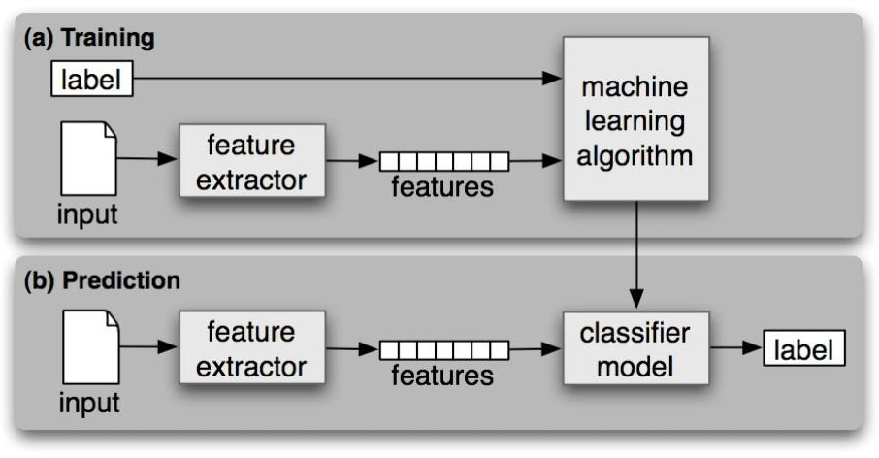
Architecture Diagram

Slide 9
Hardware Requirements
System : Pentium IV 2.4 GHz.
Hard Disk : 100 GB.
Monitor : 15 VGA Color.
Mouse : Logitech.
RAM : 1 GB.

Slide 10
Software Requirements
Operating system : Windows XP/7/10
Coding Language : Html, JavaScript,
Development Kit : Flask Framework
IDE : Anaconda prompt

Slide 11
Project Planning – Gantt Chart
Activity | Wk 1 | Wk 2 | Wk 3 | Wk 4 | Wk 5 | Wk 6 | Wk 7 | Wk 8 | Wk 9 | Wk 10
1) Submit FYP proposal
2) Collect some information and materials required for FYP
3)Start coding for the main page, login page and registration page
4) Start Coding for modules
5) Re-Check Coding and run the system for trial
6) Write final report and prepare slides for final presentation

Slide 12
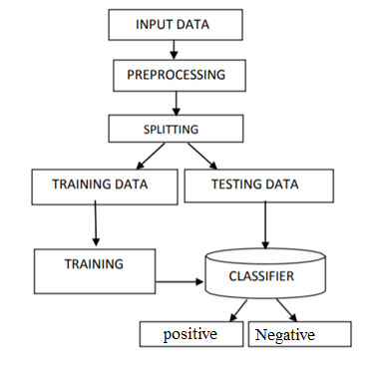
Flow Diagram

Slide 13
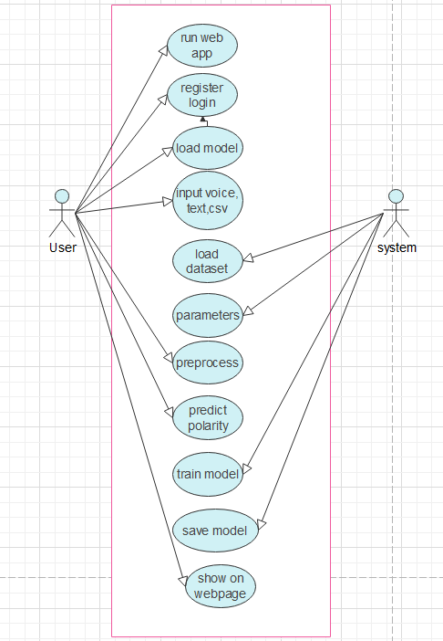
Use Case Diagram

Slide 14
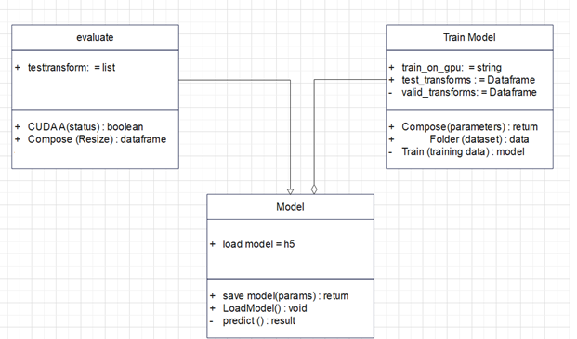
Class Diagram

Slide 15
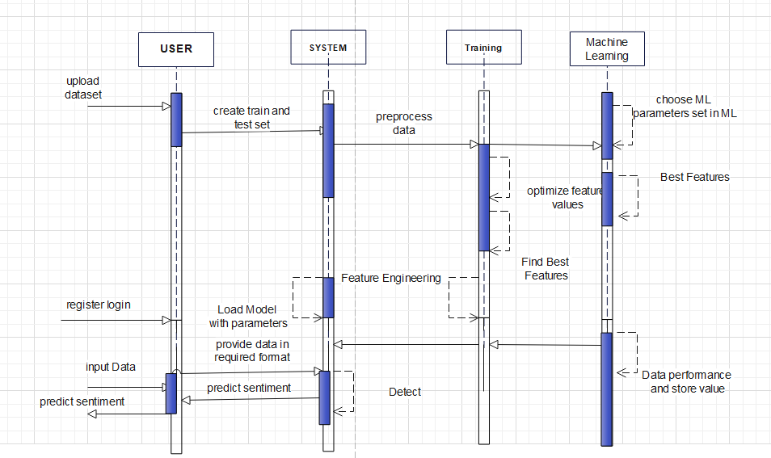
Sequence Diagram

Slide 16
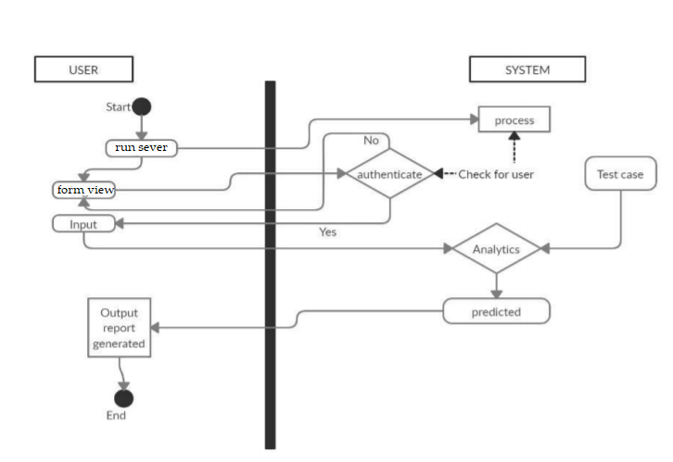
Activity Diagram

Slide 17
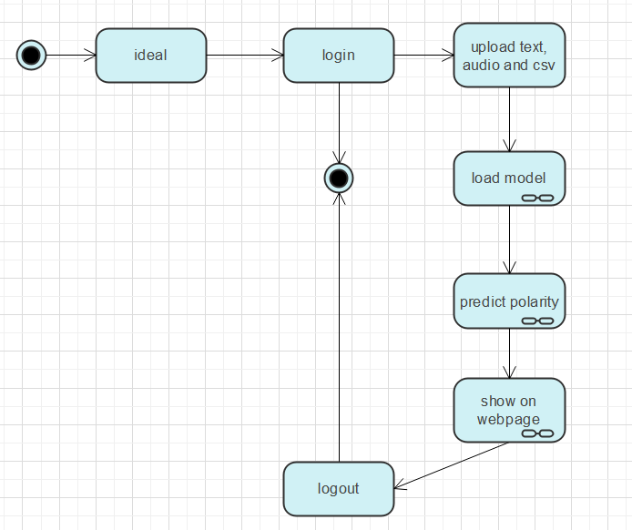
State chart

Slide 18
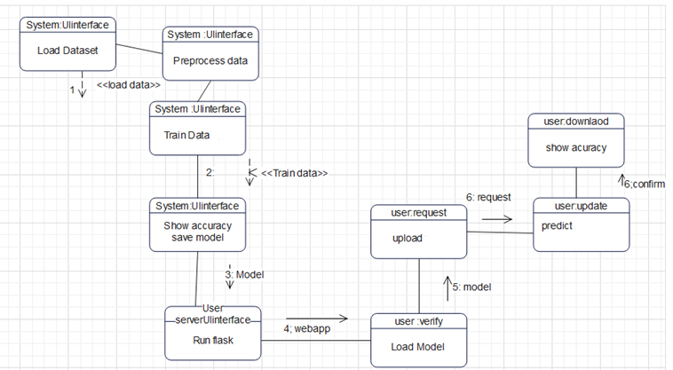
Collaboration Diagram

Slide 19
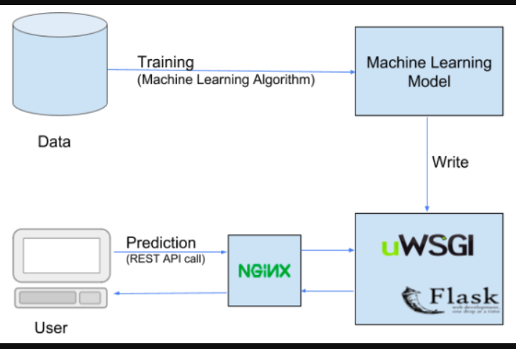
Deployment Diagram

Slide 20
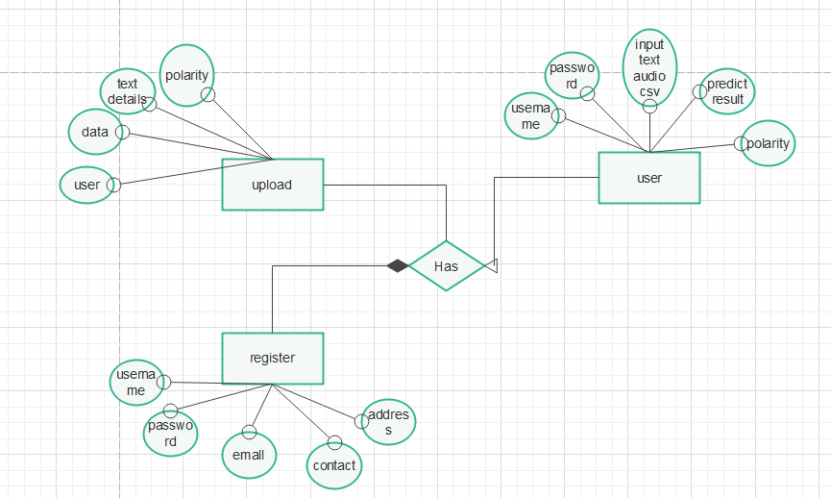

Slide 21
Modules
Dataset Collection:
we will collect emotion dataset from Kaggle website which has positive, negative, and neutral labels with tweet features.
Preprocessing Module:
This is preprocessing module where four datasets are converted to supervised learning data and then converted to single combined dataset. This dataset is used as input for application in the next for creating model.
Model training Module:
In this stage combined dataset is taken as in put and model is created using NLP and Naviye bayes classifier in three steps .
First data is dividing in to testing and training set and features and labels are extracted from these datasets and then data is trained and fitting is done. Then a pkl file is created which is model for this application.
This pkl file is used as model for predicting final results.

Slide 22
Implementation
Algorithm Steps:
Dataset Collection: In this step data set is collected from Kaggle website. Data set has features and labels. Features are used as input and labels for output.
DATA PREPROCESSING:
In this step data is pre processed by removing unwanted data and NAN values and using features and labels which are useful to fit in to algorithm and then process data for prediction.
Data split Test training:
In this stage data is divided in to test and train values using train test split function and store features and labels in to test train values. Train set is 30 percent of test set data which is used for checking accuracy of the dataset.

Slide 23
Model Training:
In this stage different algorithms are used to check which algorithm provides best accuracy and select one algorithm to use that for fitting features and labels and then run algorithm in this way model is trained.
Prediction and accuracy:
In this stage new input or test set is taken as input and given as input to predict function of the algorithm and then result of labels are as output of the algorithm.

Slide 24
Algorithm Navie Bayes Classifier
Step1: load dataset
Setp2: preprocessing data
Step3: load combined dataset
Step 4:split test and train set from dataset
Step 5: divide features and labels
Step 6: fit train and test set
Step 7: collect input data and give to predict function to get (positive, negative,neutral) values

Slide 25
Conclusion
In this project we are developing sentiment analysis using using machine learning algorithm. In this project Naviye Bayes algorithm with NLP is used to predict positive negative or neutral sentiment for audio, text and csv file data.
Best accuracy algorithm is used to train and test data and prediction is shown using web page.

Slide 26
Future scope
In future scope we use deep learning algorithms with sentiment analysis with emotions in the tweet and improve sentiment analysis in better way.

Slide 27
References
[1] Liu, B.: Sentiment Analysis and Opinion Mining. Synthesis Lectures on Human Language Technologies. Morgan & Claypool Publishers, 2012.
[2] Plaza, L.—Carillo de Albornoz, J.: Sentiment Analysis in Business Intelligence: A Survey. In: Colomo-Palacios, R., Varaj˜ao, J., Soto-Acosta, P. (Eds.): Customer Relationship Management and the Social and Semantic Web: Enabling Cliens Conexus. Chapter 14. IGI Global, Hershey, PA, 2012, pp. 231–252.
[3] Azevedo, A.—Santos, M. F.: Integration of Data Mining in Business Intelligence Systems. IGI Global, Hershey, PA, 2015, doi: 10.4018/978-1-4666-6477-7.
[4] Bakliwal, A.—Foster, J.—van der Puil, J.—O’Brien, R.—Tounsi, L.— Hughes, M.: Sentiment Analysis of Political Tweets: Towards an Accurate Classifier. NAACL Workshop on Language Analysis in Social Media, Atlanta, GA, 2013, pp. 49–58.
[5] Mejova, Y.—Srinivasan, P.—Boynton, B.: GOP Primary Season on Twitter: “Popular” Political Sentiment in Social Media. Proceedings of the Sixth ACM International Conference on Web Search and Data Mining, New York, NY, 2013, pp. 517–526, doi: 10.1145/2433396.2433463.

